Slide 1


EXPLORING TEST PORTAL FOR TEACHING LEARNING
Dr. Ansar Ahmad
Department of Teacher Training & Non Formal
Education (IASE), Faculty of Education,
Jamia Millia Islamia, New Delhi.
Email: aahmad19@jmi.ac.in

Slide 2
OUTLINE
Assessment: Need and Importance
NEP-2020: Recommendation for Assessment
How do we Assess Learners?
What are We going to Explore in Test Portal?
Essential Requirement to Create Test Portal
Exploring opportunities of Test Portal
Exploring Challenges associated with Test Portal
Mitigating Challenges and maximizing Opportunities of Test Portal
2

Slide 3
Assessment: Need and Importance
Assessment is the systematic collection of information about students learning, using the time, knowledge, expertise, and resources available in order to inform decisions that affect student learning (Walvoord, 2010).
To find out what the students know (knowledge).
To find out what the students can do, and how well they can do it (skill; performance).
To find out how students go about the task of doing their work (process).
To find out how students feel about their work (motivation, effort).
3

Slide 4
NEP-2020: Recommendation for Assessment
The aim of assessment transform the nature of learning from one that is summative and primarily tests rote memorization skills to one that is more regular and formative.
It is more competency-based, promotes learning and development for our students, and one that tests higher-order skills, such as analysis, critical thinking, and conceptual clarity.
The primary purpose of assessment will indeed be for learning.
4

Slide 5




How do we Assess Learners?
Formative assessments (Assessment for learning, or as learning)
Summative assessment (assessment of learning)
Provides feedback for teachers to adjust ongoing teaching and learning
Provides data for teachers to make evidence-based decisions for interventions
Used to improve students’ achievement of intended instructional outcomes
Used to find out if instructional goals have been met (pass or fail)
Provides data to adjust curriculum for future student cohorts
5

Slide 6



When do we assess Learners?
During Teaching
(Assessment for learning)
Before Teaching
(Assessment for learning)
After Teaching
(Assessment of learning)

Slide 7
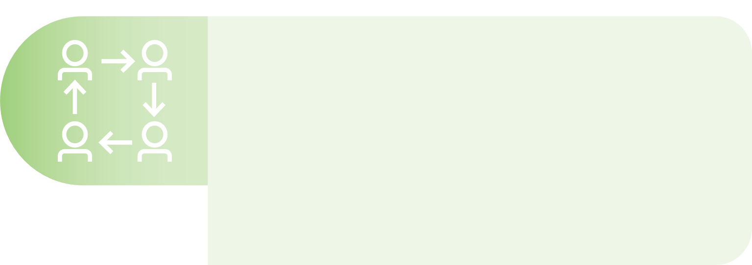
Assessment Tools
Formative Assessments (before and during Teaching)
Face-to-face environment
Group work
Class exercises
Peer evaluation and review
Quizzes
Online environment
Online quizzes
Online forums
Chats
Video conferencing
Gamified exercises

Slide 8
What are we going to explore in Test Portal?
What
Why
How
Where

Slide 9
Test Portal
It is an easy test maker designed to save time and give actionable insights when conducting online assessments.
It is loaded with practical features, such as automatic question grading and offers in-depth test results for particular test respondents as well as whole groups.
It is an examination platform that allow a teacher to conduct proctored exam, test, quizzes etc.
This platform allows the scope to evaluate learners with different types of assessment.
9

Slide 10


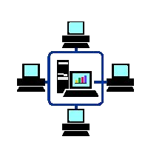
Essential requirement to Create Test Portal
Desktop
Google Account
Internet
10

Slide 11

How?
04
Step-4
Step-2
Create your Assessment tool
02
Sign up with Google Account
Step-1
03
Step-3
Go to –
https://ww w.testportal.net/
Explore and learn
01
www.yourwebsite.com

Slide 12
Exploring opportunities of Test Portal
Flexibility
Data Driven Instruction
Interactive Test Format
Immediate Feedback

Slide 13
Exploring Challenges of Test Portal
Technical
Academic Integrity
Access and Equity
Digital Literacy
Data Privacy

Slide 14
Mitigating Challenges & maximizing Opportunities of Test Portal
Offer Technical Support
Ensure Accessibility & Equity
Ensure Academic Integrity
Improve Digital Literacy
Ensure Data Security

